Slide 1
Finding the sweet spot in camera trapping: a meta-analysis of camera trap papers to test for reported sampling effort in population estimates.
Nargol Ghazian & Christopher J. Lortie

Slide 2
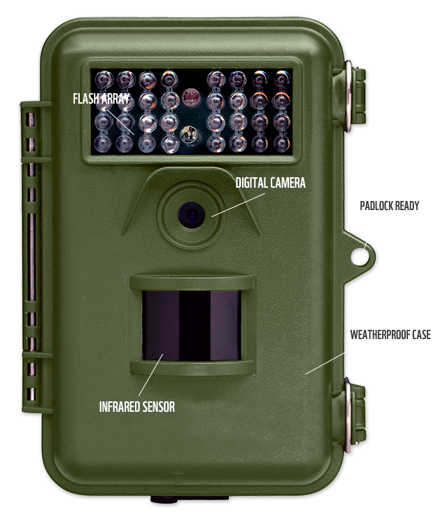
Overview
Camera traps are a popular tool in wildlife studies.
Reviewed 252 full-text articles to test for the relationship between trapping effort and vertebrate diversity
Net positive effect for increasing number of cameras, especially in certain systems.
Longer trapping duration did not increase capture rate of diversity.

Slide 3
Background
Record animal presence via a triggered passive, infared motion sensor.
One of the most popular survey tools for population estimates such as occupancy, abundance, and diversity.
Trapping rate = ratio of photographs to camera trapping time (Rovero and Marshall 2009).
2 categories: trapping design and trapping effort.

Slide 4
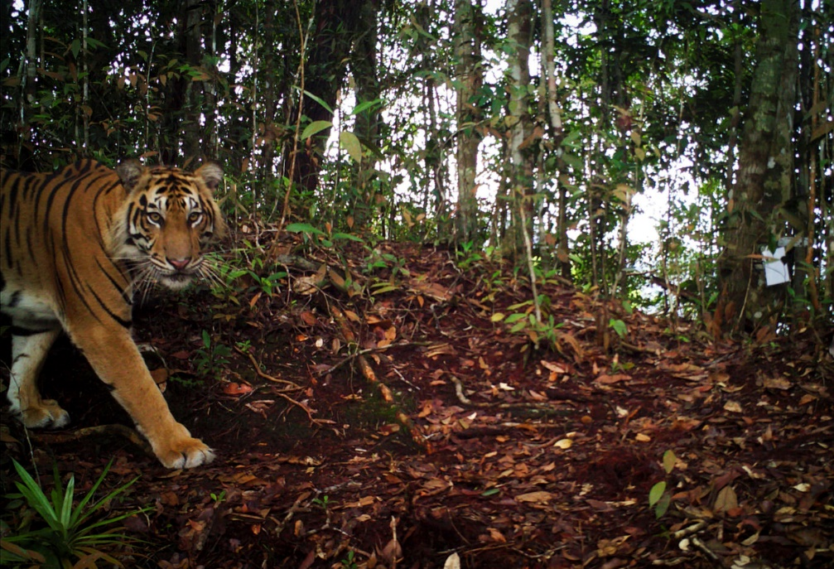
Background
Minimum Trapping Effort (MTE) = number of camera trap days required to record species of interest in an area (Si, Kays, and Ding 2014).
Opportunity to explore the relationship between trapping time, number of cameras, and richness estimates across the literature.
Tested the threshold of sampling.
Provided an overview of the relationship between trapping rate and richness.
Tested the effects of ecosystem.

Slide 5
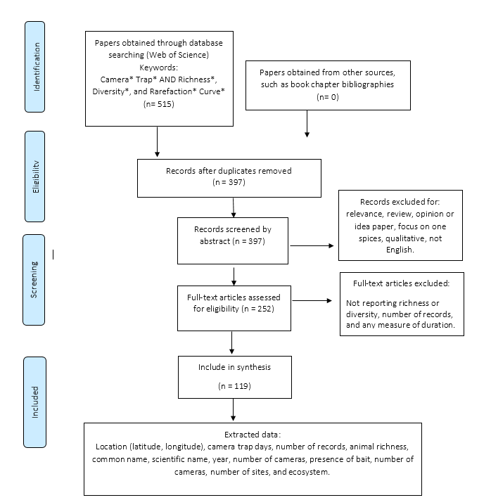
(Moher et al. 2009)
Notes:
(Moher et al. 2009)

Slide 6
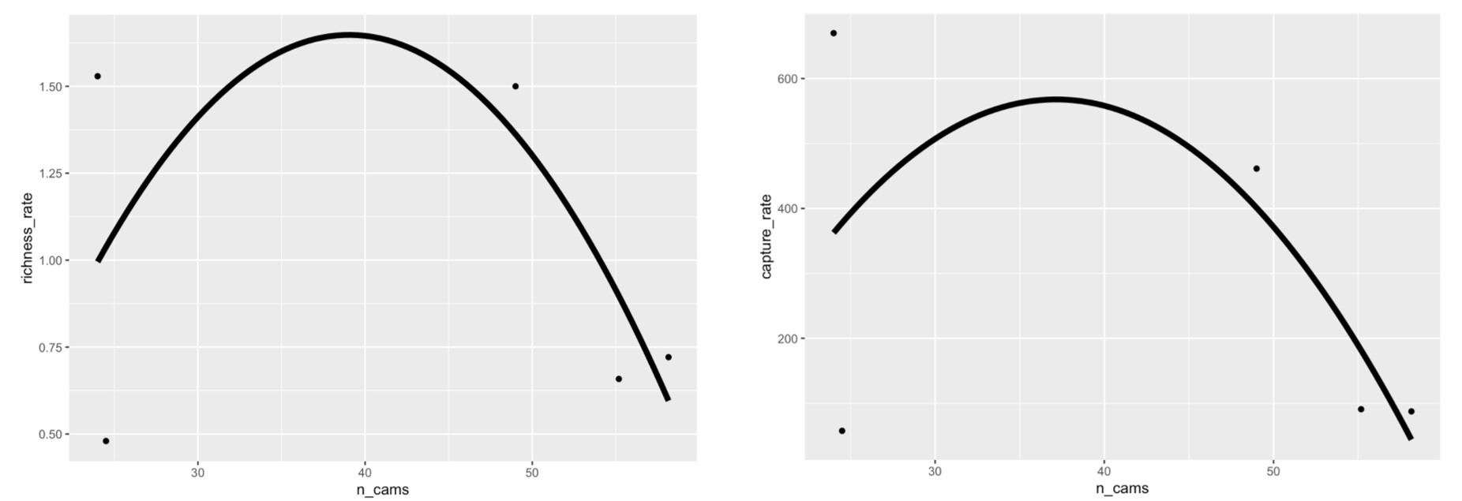
Figure 1. Scatter plot depicting the relation between the number of cameras (n_cams) and richness (left) and capture (right) rate. Smoothed conditional means are fitted to a linear model.

Slide 7
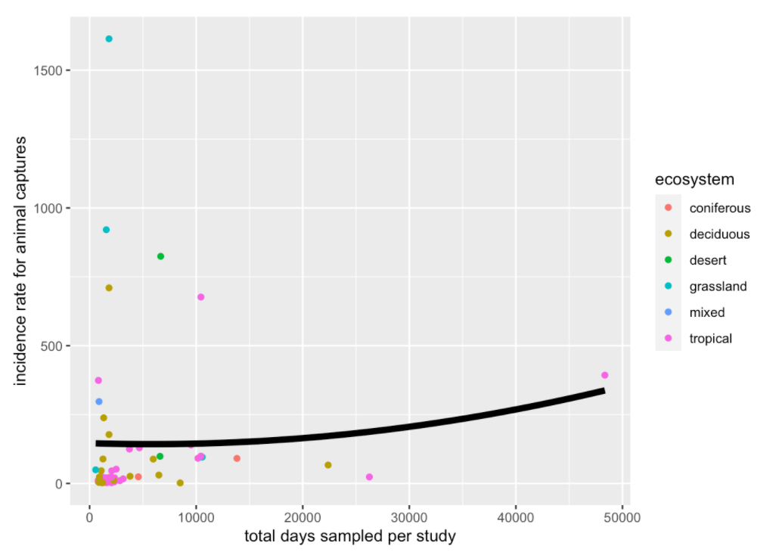
Figure 2. Scatterplot showing the relationship between the number of camera trap study days and incidence rate for animal captures. Smoothed conditional mean is fitted using the linear model. Coloured dots represent different ecosystems.

Slide 8
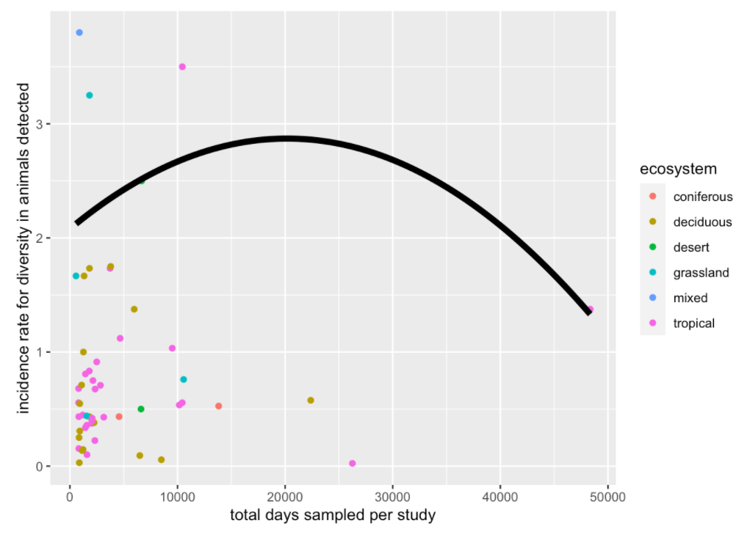
Figure 3. Scatterplot showing the relationship between the number of camera trap study days and incidence rate diversity of animals detected. Smoothed conditional mean is fitted using the linear model. Coloured dots represent different ecosystems.

Slide 9

Findings
Net effect of increasing the number of cameras was positive.
Increase in the number of cameras resulted in the highest captures of animal diversity.
To deploy more camera traps for a shorter duration rather than to deploy fewer camera traps for a longer one, for any give number of trap days.
Systematic trap placement design or a design suited to the habitat may be appropriate if the primary goal of the survey is richness estimation (O’Brien 2008).

Slide 10
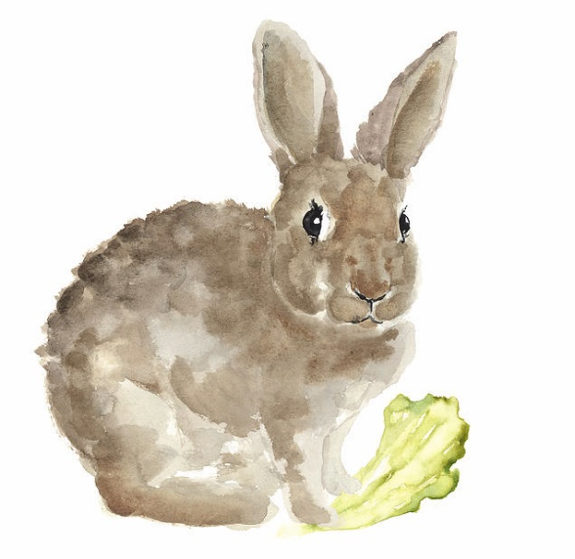
Findings
Increasing the number of days does not augment the capacity of cameras to sense more animals, in the number of captures or diversity, in any of the systems.
increasing the number of camera sites and rotating cameras to new sites is more efficient for richness estimates as opposed to leaving cameras at the same site for a longer duration of time.

Slide 11

Findings and Implications
Increasing the number of cameras significantly increased the rate of animal captures in deserts and grasslands.
Future challenges for researchers will include well-planned experimental designs to maximize the extent of surveys.
See a rise in their cross implementation in AI environmental monitoring studies.

Slide 12


Thank You!
Dr. Chris Lortie
Dr. Suzanne MacDonald
Jenna Braun

